Slide 1
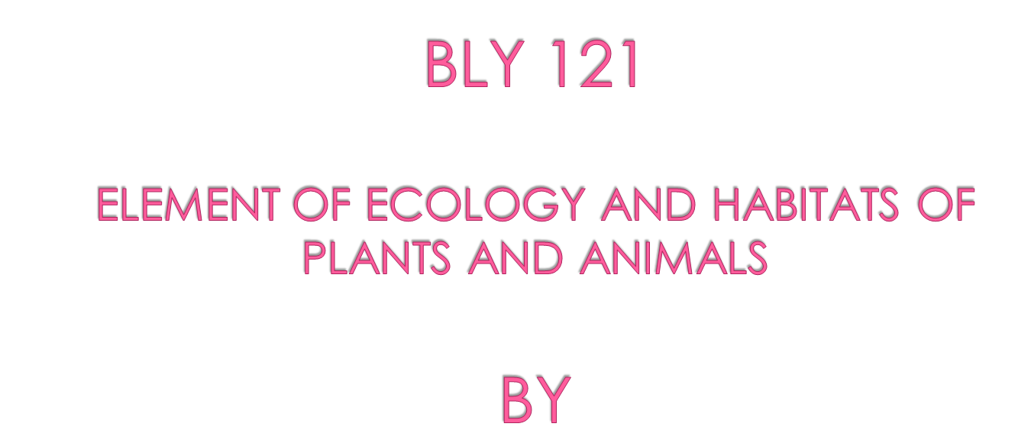


Slide 2

Definition
Habitat is defined as a place or locality where an organism or a group of organisms live.
It is the habitat that harbours the environment of the organisms and is also where the functioning used in characterizing ecosystems, operates.
The habitat is also referred to as the physical portion of the environment where an organism or a group of organisms live.

Slide 3

Because of their diverse nature, habitat has been classified using different basis:
Based on size:
Habitats are generally grouped into two: microhabitat and macrohabitats.
Macrohabitats are large-sized habitats such as the tropical forests, the savanna, rivers, the lagoons, the oceans e.t.c.
The microhabitats are small-sized habitats such as the hole, where some insects are living
These habitats also carry climates reflecting their sizes.
The macrohabitats carry macroclimates, while microhabitat carry microclimate

Slide 4
Based on the bulk of fluid medium
They are classified into two major groups: Aquatic and Terrestrial Habitats.
Aquatic habitats have water as the bulk of their fluid medium
The terrestrial habitats on the other hand have air as their fluid medium
AQUATIC HABITATS
Aquatic habitats can be further grouped into three types, based on their salinity i.e. the amount of salt in them. These 3 groups include:
Marine habitats
Freshwater habitats
Brackishwater habitats

Slide 5



They have very high salinity.
They collectively constitute well over 70% of the world biosphere.
They have large convectional currents and large waves in them
They are under the influence of much pressure
They are expectedly very deep, up to 11000m
Their temperature varies with increasing depth

Slide 6
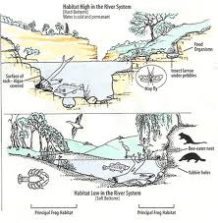
Light only penetrates to about 200 meters in the water body
The P^{H} is slightly alkaline
The surface water in marine habitats have much oxygen concentration which decreases as depth increases

Slide 7



They are aquatic habitat with little salinity which is usually less than 1 ppt
They vary in sizes.
There is not much pressure in them
They are usually not very deep
Their density is usually 1
Their temperatures vary with the location of such freshwater bodies
Light can only penetrates up to the depth of 200m (photic zone).

Slide 8
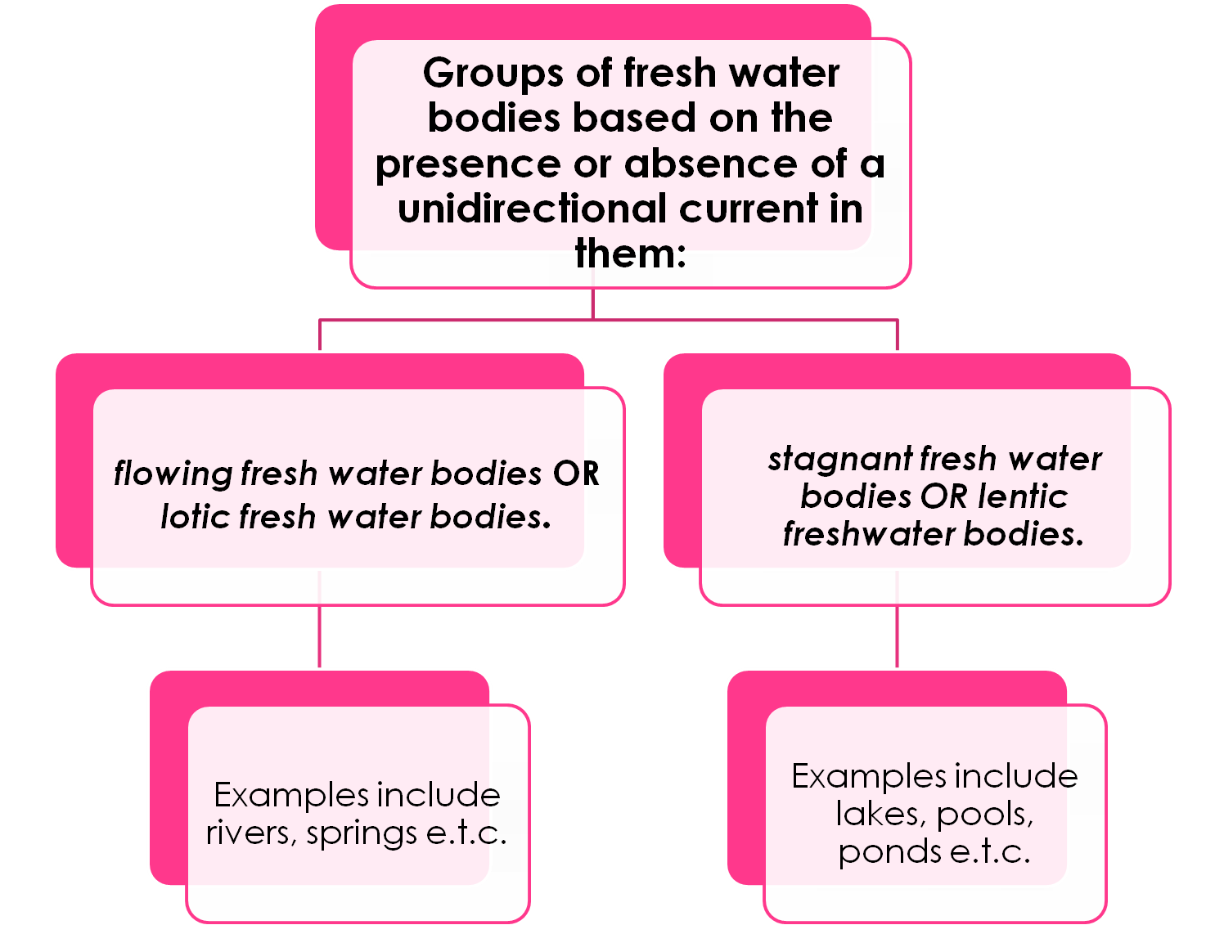

Slide 9
For plants:
Obtaining enough sunlight for photosynthesis
Obtaining enough dissolved oxygen in water
Absorption of water and mineral nutrition
Buoyancy in water
For Animals
Buoyancy in water
Breathing in water
Feeding in water
Reproduction in water
Protection from enemies in water
However, in spite of these challenges, nature has equipped the plants and animals with diverse adaptive features that enable them to survive within water bodies.

Slide 10



These are aquatic habitats that have their salinity in between 1 to 35ppt
They are found in places where freshwater bodies of the inland and marine water bodies meet and mix
produce a peculiar type of vegetation known as mangrove swamp vegetation

Slide 11

They are also of varying sizes
They may or may not have currents
They do not feel pressure impact so much
They are not usually very deep
They normally experience daily and seasonal salinity
They have seasonal rainfall

Slide 12
They are poorly aerated with low oxygen content and high content of hydrogen sulphide and sulphur dioxide.
These are responsible for the rotten egg odour of the environment.
The plant communities found in this habitat are located in different zones namely:
The Water Edge Zone of Thicket, The Sand Mangrove Zone, The Mud Mangrove Zone, The Landward Zone.
The animal communities of brackishwater habitats include the following: Zooplankton, bottom living fauna, other Mangrove fauna

Slide 13

These are the land habitats and are classified on the basis of the types of vegetation they carry.
The various types of vegetation on the other hand, determine the types of animals found within these land habitats.
Types of Terrestrial habitats in Nigeria
Mangrove swamp

Slide 14
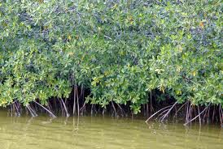
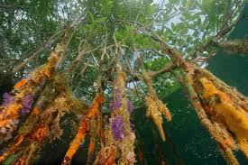
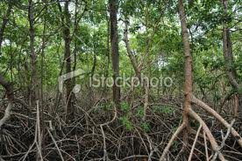

Slide 15

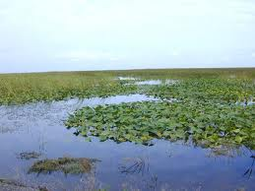
Freshwater swamp

Slide 16

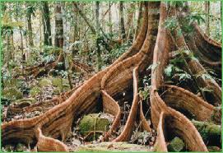
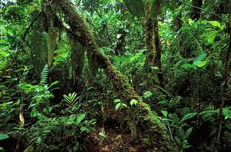
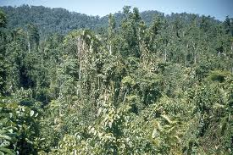

Slide 17

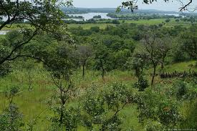

Slide 18

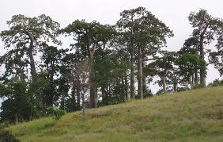
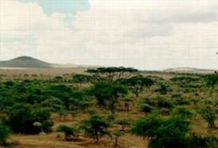
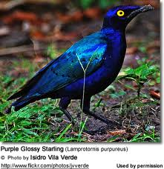

Slide 19



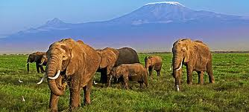
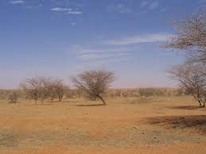

Slide 20


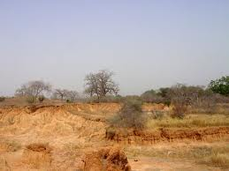
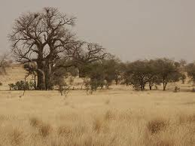


Slide 21
Each of these main terrestrial habitats has its peculiar ecological characteristics which make people recognise it.
These ecological characteristics include:
their distribution in the Country
the climatic conditions
the features of their soils
their physiognomy
their life forms
their floristic compositions
their faunal compositions
the challenges to life there e.t.c

